Slide 1
PROJECT REVIEW
1.INTRODUCTION
(I) OVERVIEW
IN THIS MODERN ERA PEOPLE STARTED THEIR OWN INDUSTRIES
ACROSS THE WORLD THIS HAS BEEN A RAISED YEAR BY YEAR WHICH REALLY REGULATES THE STANDARD OF OUR COUNTRY AND A PERSONS WELL BEING.THIS INCLUDES PRIMARY ,TERTIARY AND SECONDARY SECTOR.
PEOPLE STARTED THEIR OWN INDUSTRY TO FIND A TRUE MEANING AND PURPOSE IN A CAREER.THE IDEA OF BUILDING A COMMUNITY OR GIVING BACK .A DESIRE TO CREATE JOBS AND CONTRIBUTE TO A LOCAL ECONOMY.
A PASSION FOR FOLLOWING ONES DREAM AND MAKING A DIFFERENCE IN THE WORLD
ACCORDING TO REPORT MAHARASTRA HAS PLACED A VITAL ROLE IN CASE THIS ANALYSIS IN INDIA IN ALL SECTORS
(II) PURPOSE
USINF THIS PROJECT ONE CAN ANALYZE STATISTICAL DATA OF INDUSTRIES STARTED IN INDIA AND CAN FIND A PROPER SOLUTION FOR AN STARTUP

Slide 2
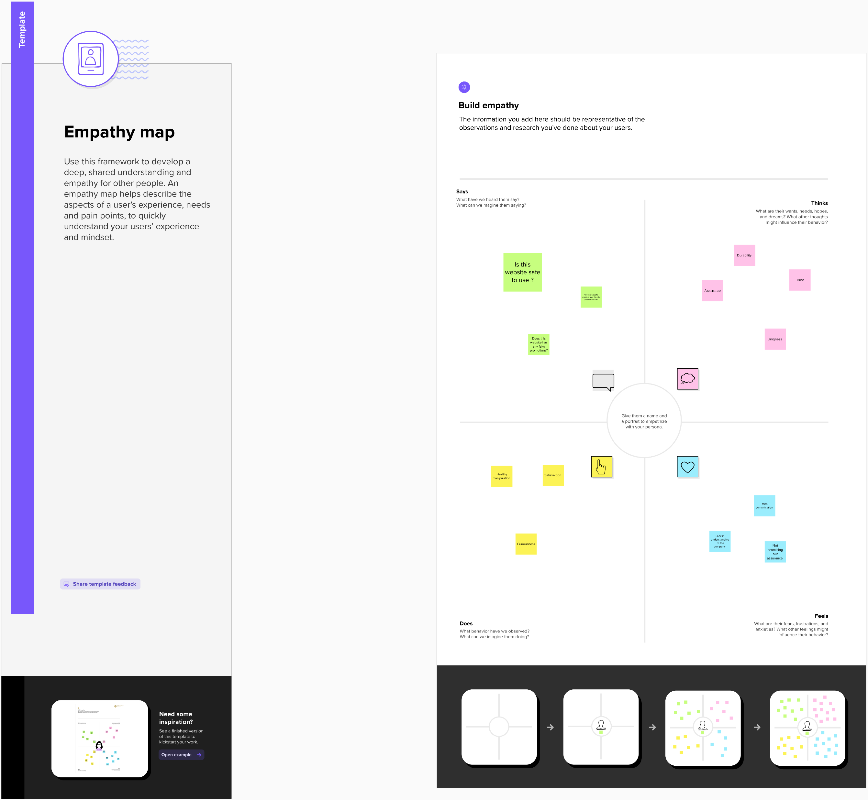
2. PROBLEM DEFNITION AND DESIGNING 2.1 EMPATHY MAP

Slide 3
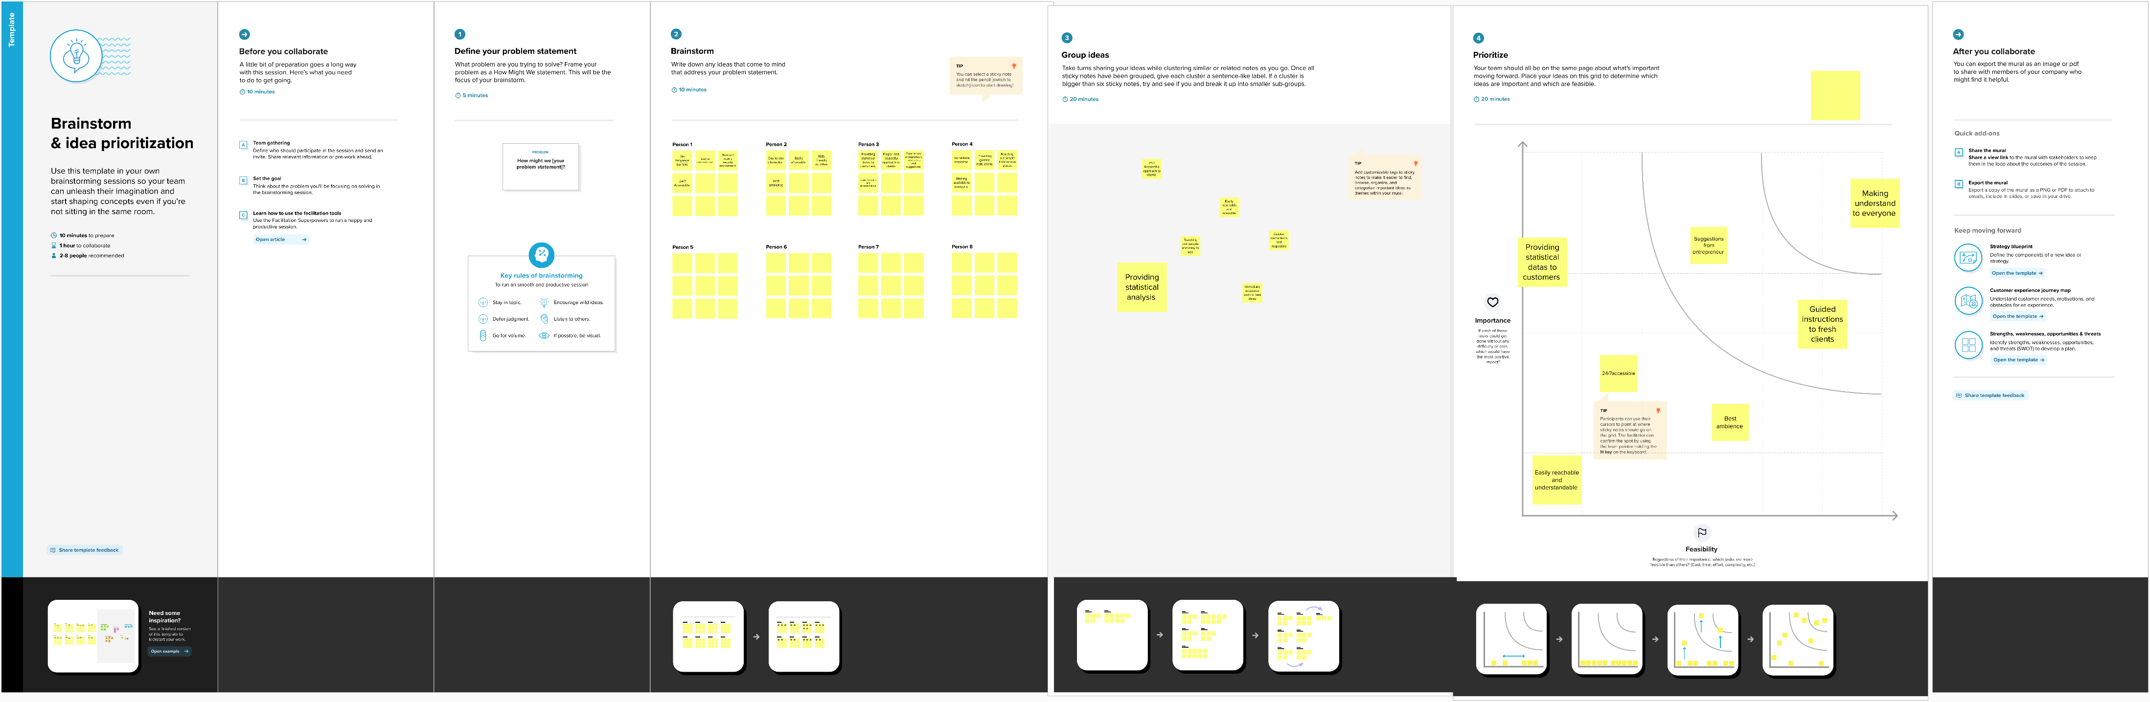
2.2 IDEATION AND BRAIN STORMING

Slide 4
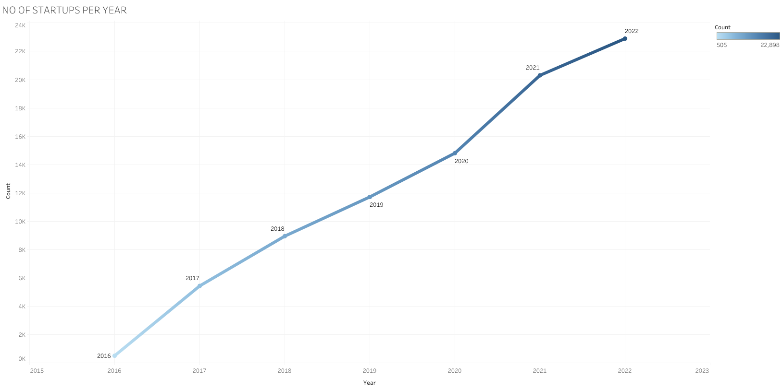
3.RESULTS

Slide 5
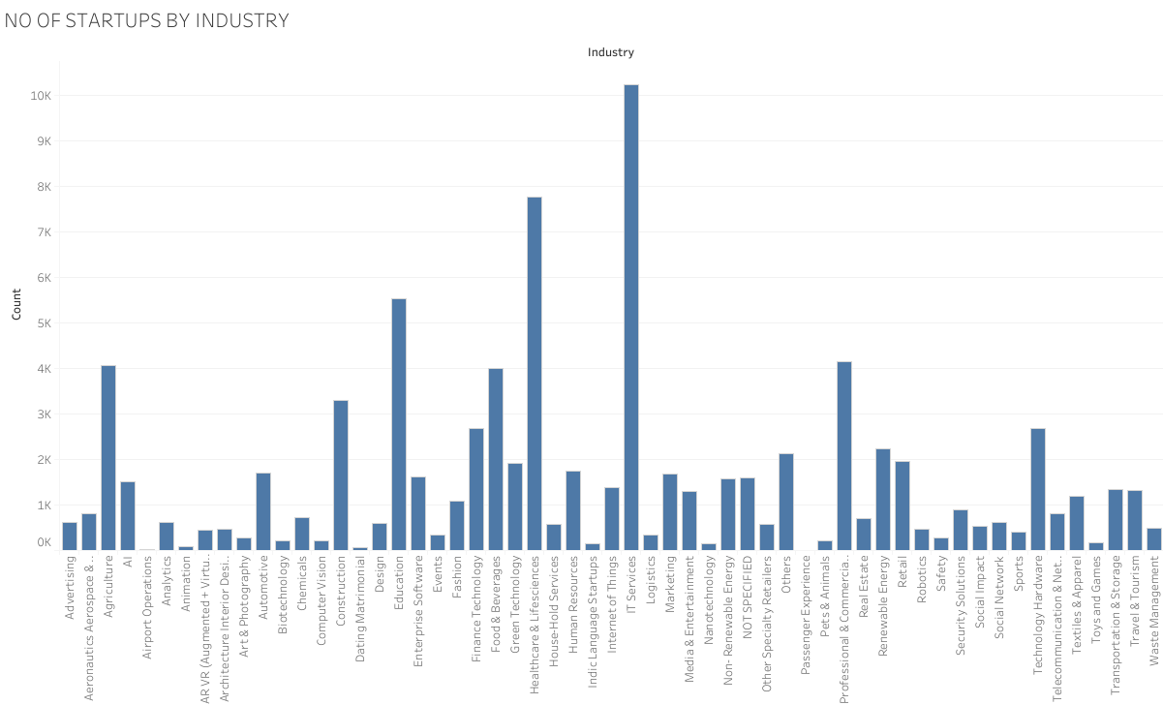

Slide 6
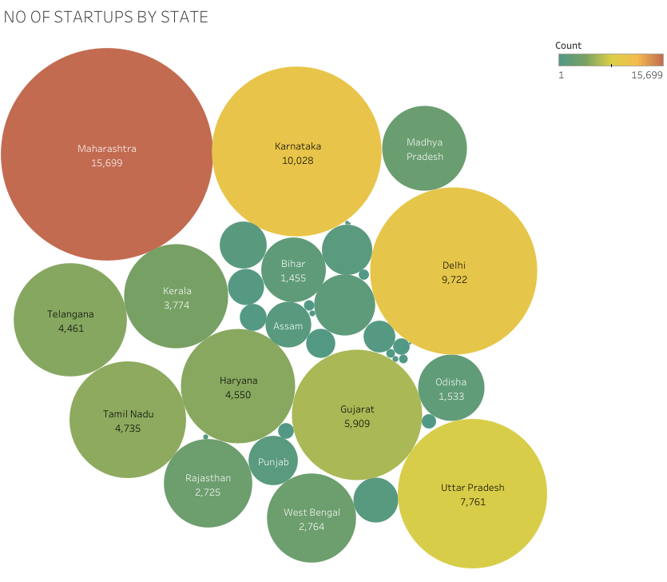

Slide 7
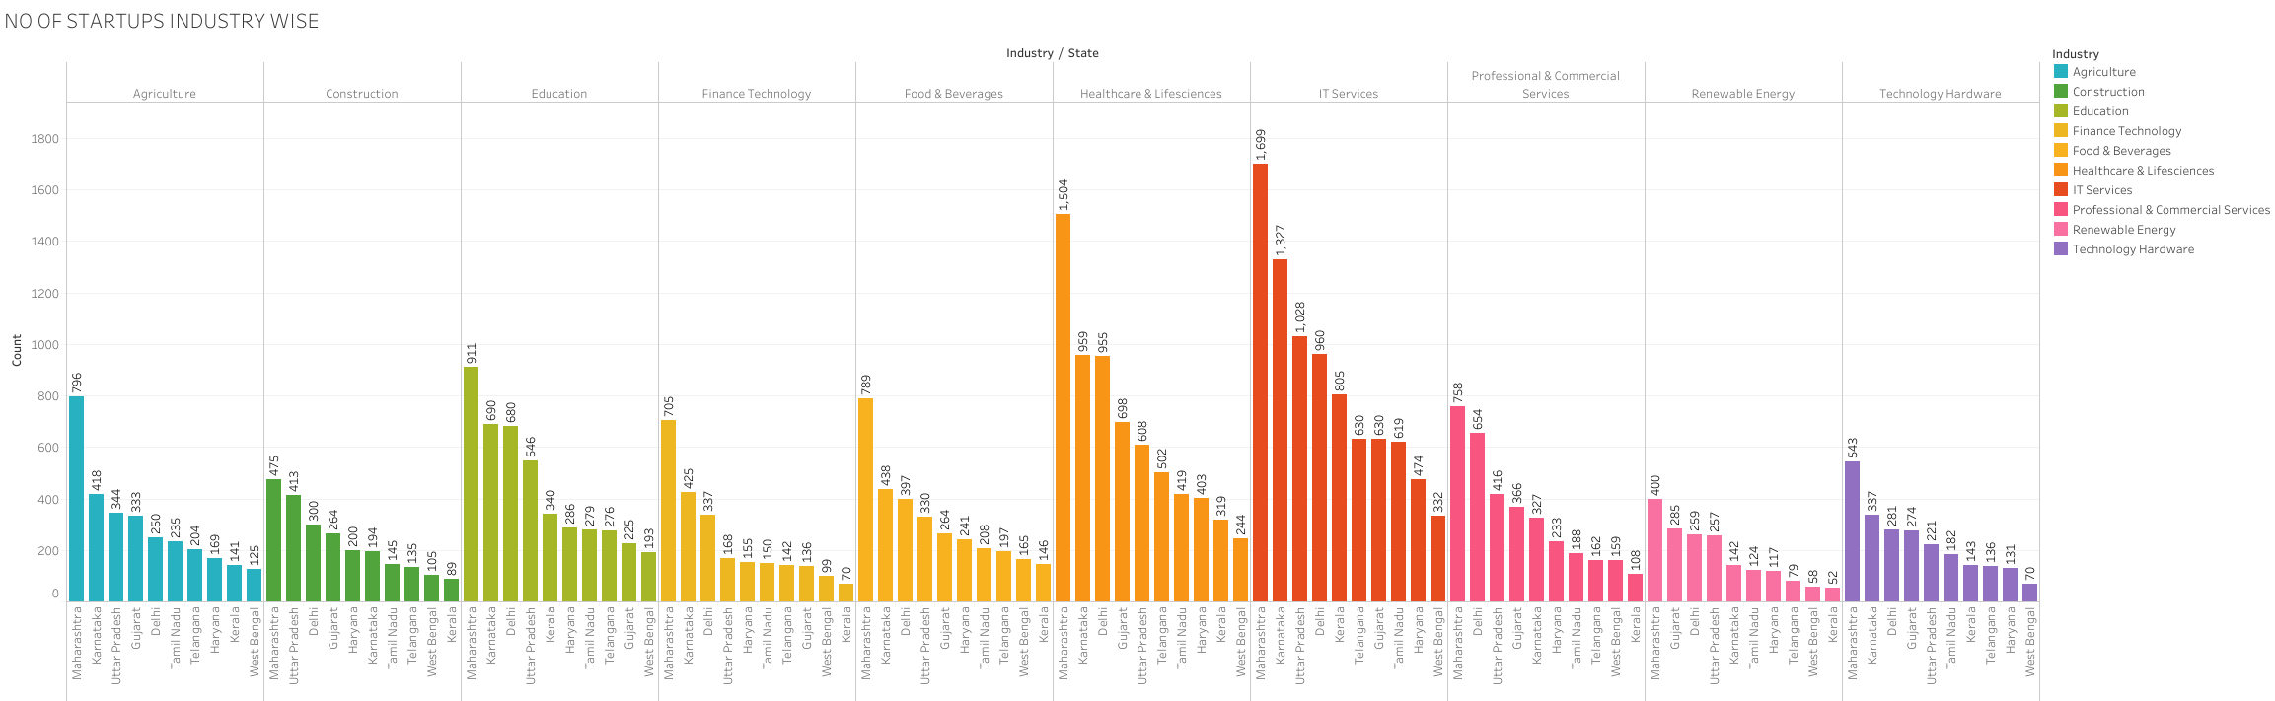

Slide 8
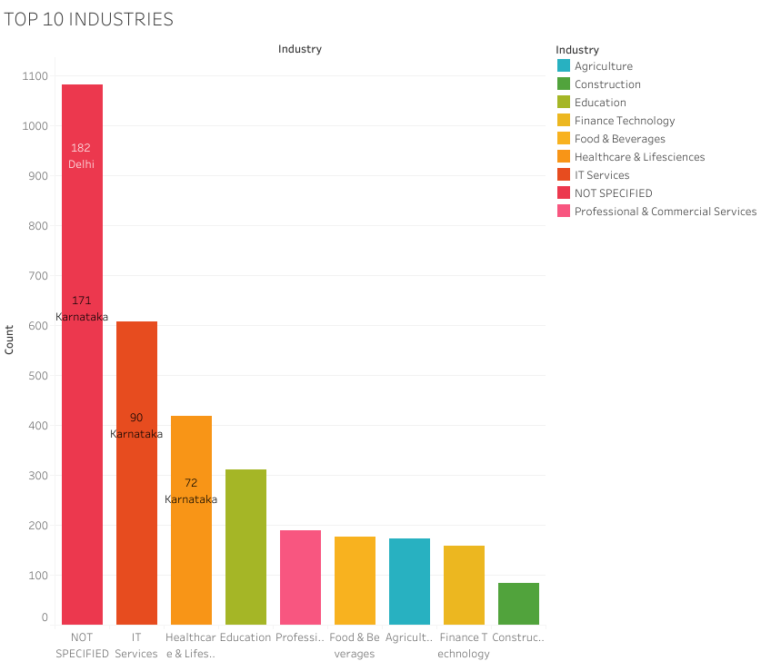

Slide 9
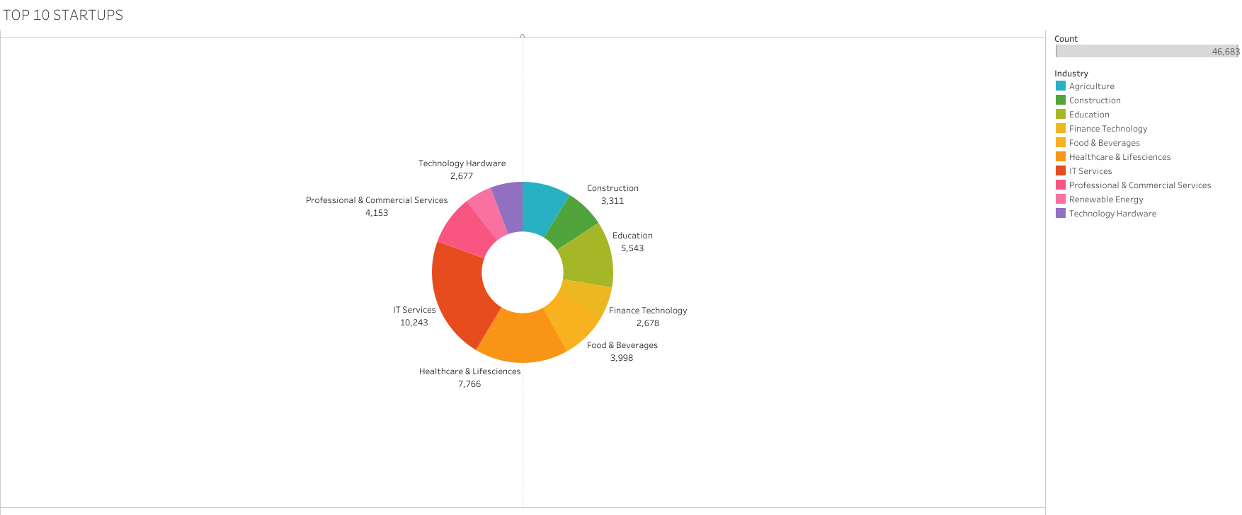

Slide 10
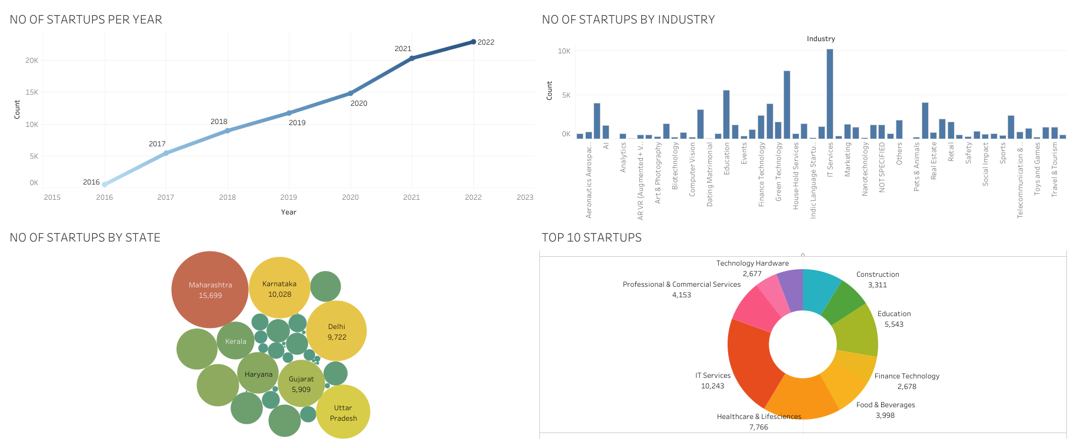
DASHBOARD

Slide 11
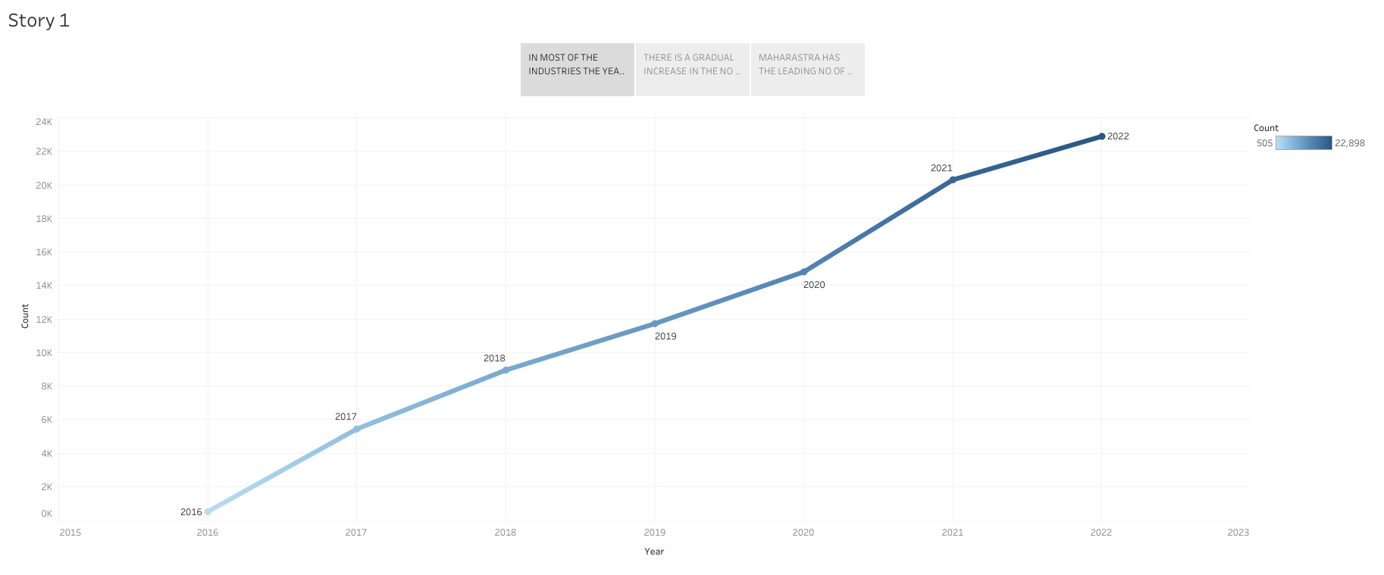
STORY BOARD

Slide 12
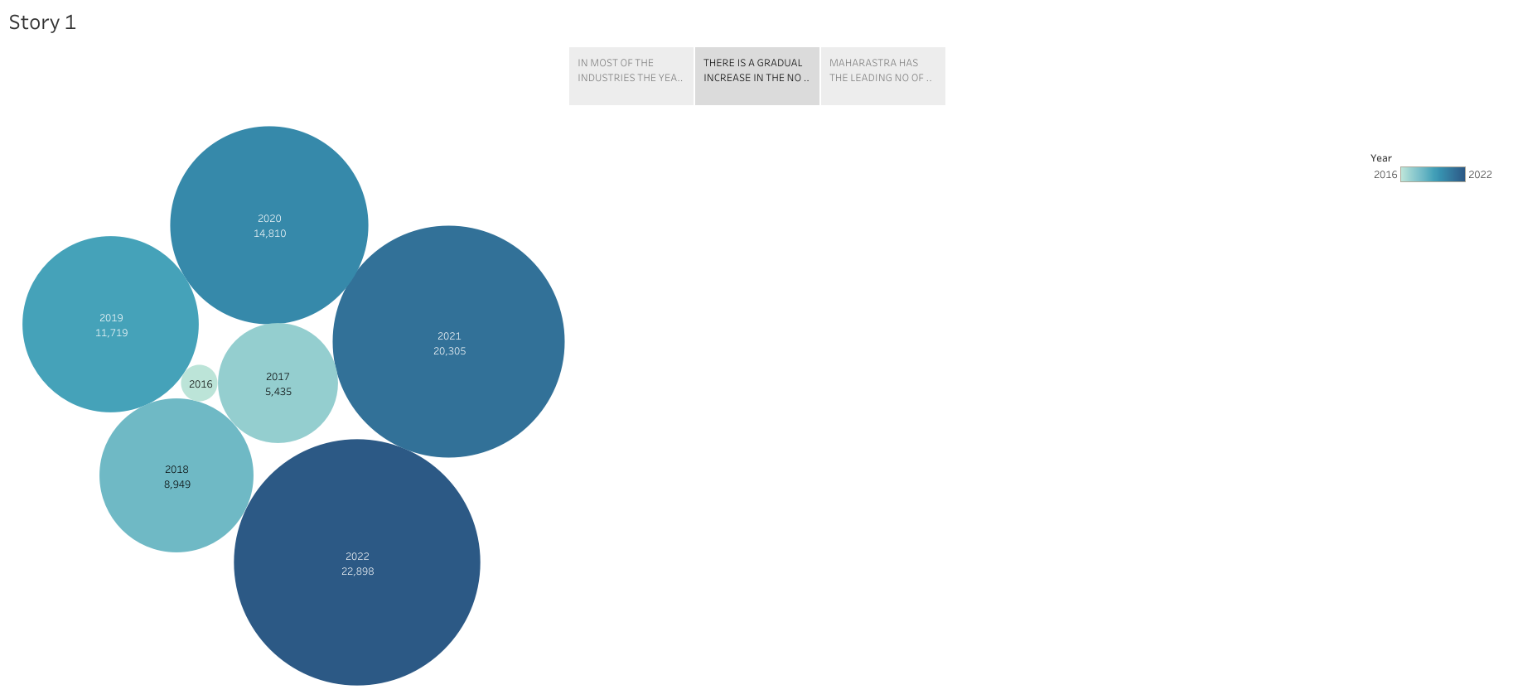

Slide 13
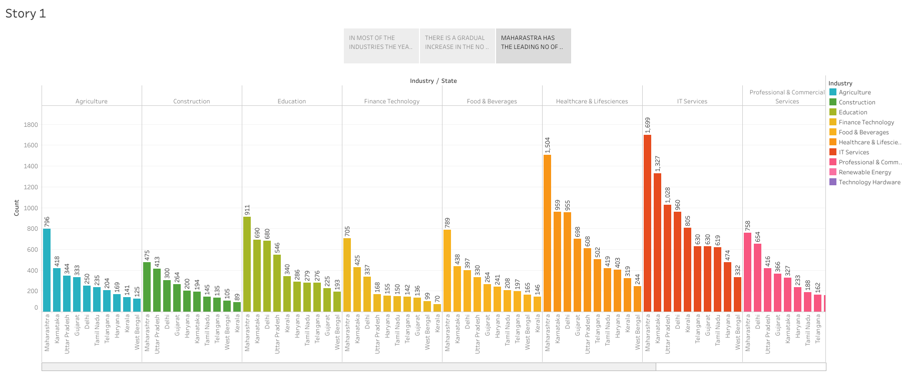

Slide 14
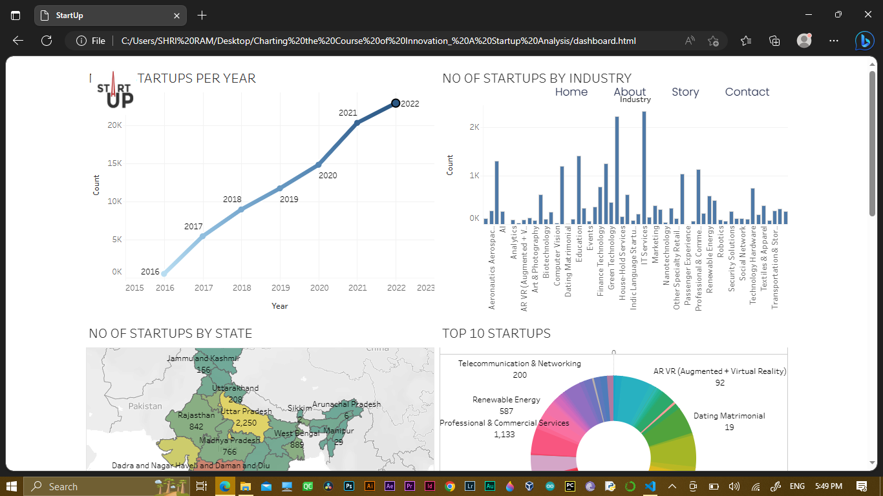
WEB INTEGRATION

Slide 15
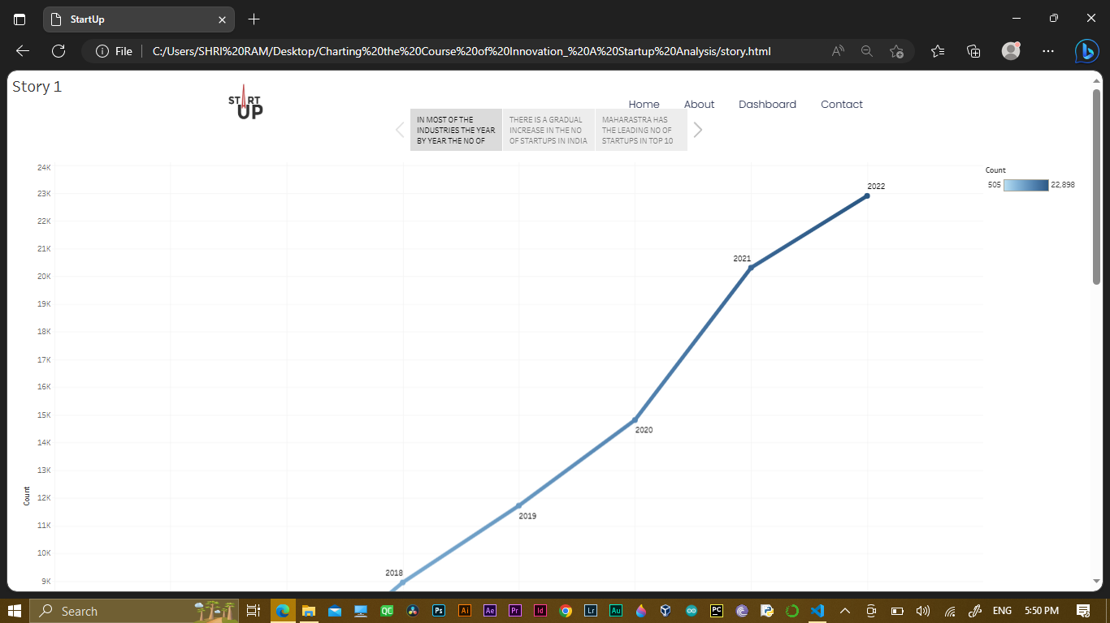

Slide 16
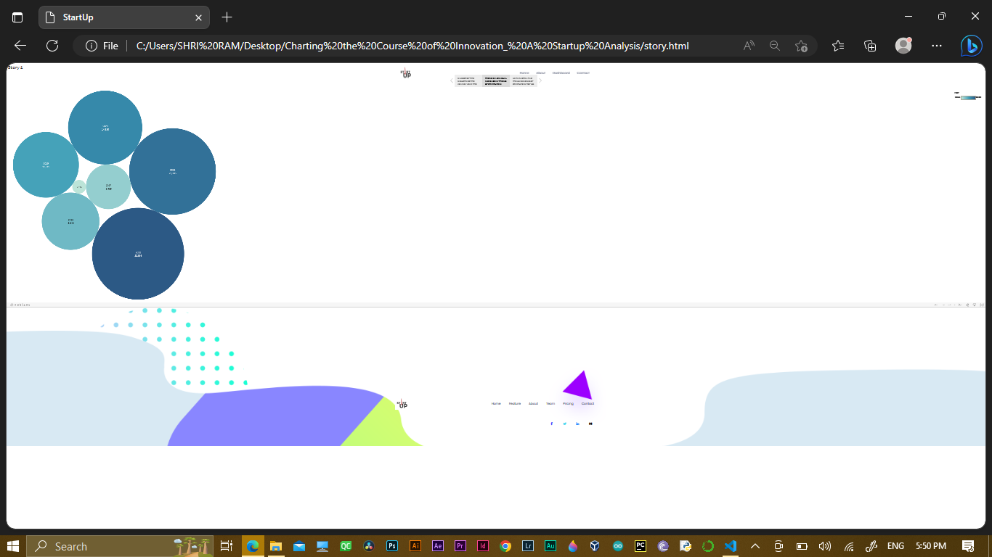

Slide 17
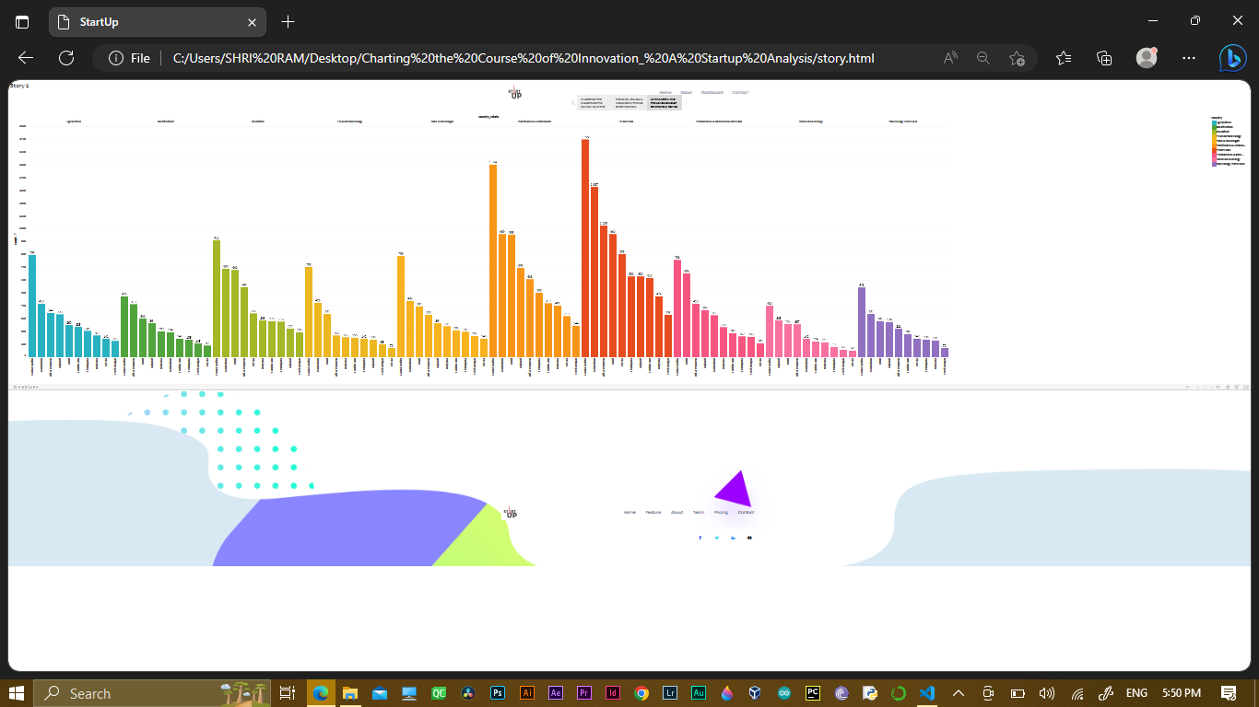

Slide 18
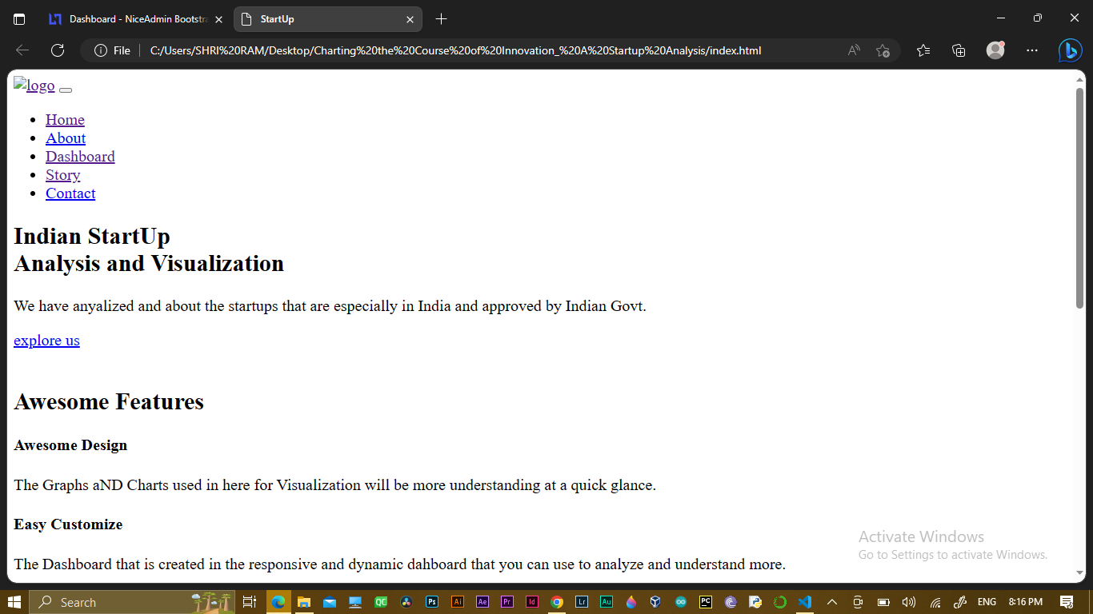

Slide 19
4.ADVANTAGES AND DISADVANTAGES
SHOWS THE ACCURATE DATA OF THE INDUSTRY AD THEIR RESPECTIVE STATES
CAN FIND THE STATES WHICH ARE HAS MORE GROWTH YEAR BY YEAR
SHOWS THE STRENGTH OF THE STATE ON THE ANALYSES OF STARTUP BUISNESS
FINANCIAL RISKS
UNDESIRABLE DUTIES
NOT RESERCHING PROPERLY BEFORE STARTING A BUISNESS
LACK OF TIME COMITMENT

Slide 20
5.APPLICATIONS
IN THE FIELD OF STARTING THEIR OWN BUISNESS
6.CONCLUSION
THROUGH THIS PROJECT WE UNDERSTAND THAT HOW TO ANALYZE A DTA AND HOW TO CREATE GRAPH
THE DATA USING TABLEAUE SOFTWARE.FROM THE DASHBOARD AND STORYBOARD CLEARLY SHOW THE STATES WHICH HAS MORE INTREST STARTING THEIR OWN STARTUPS
THE MORE OF STARTUPS IN STATE THE MORE THE FINANCIAL INDPENDENCE
FINALLY WE STUDIED THE APPLICATION OF DATA ANALYTICS IN VARIOUS FIELDS
7.FUTURE SCOPE
IMPROVING THE SPEED OF TABLEAUE SOFTWARE
ALLOWING THE PERMITABLE USERS TO EDIT THE WORKBOOKS
INCRESING THE LICENSE TIME FOR SERVERS

